Slide 1
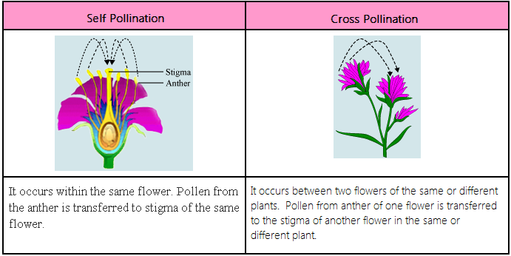
Events after Pollination and the Process of Embryogenesis
Pollination is the transfer of pollen from the anther to the stigma of a flower.

Slide 2
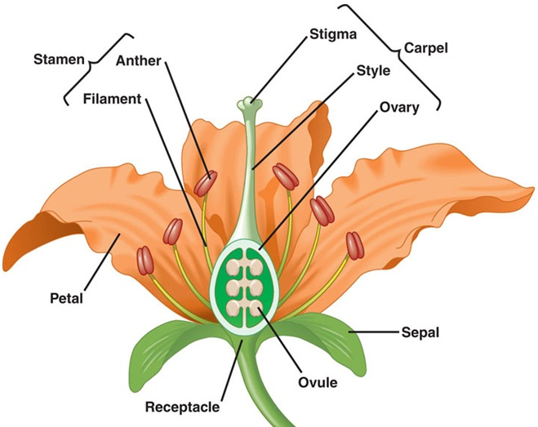
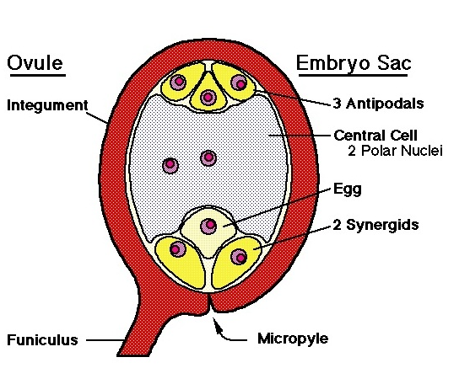
Events after pollination
The Mature Embryo Sac
The mature embryo sac is made up of seven cells with a total of eight nuclei and has an opening called the micropyle.
At the micropylar end of the embryo sac, there are three cells; two synergid cells and an egg cell. In the middle of the embryo sac, there is a large cell with two nuclei called polar nuclei.
Opposite the micropylar end are three antipodal cells. The arrangement of these cells in the embryo sac varies with different plants.

Slide 3
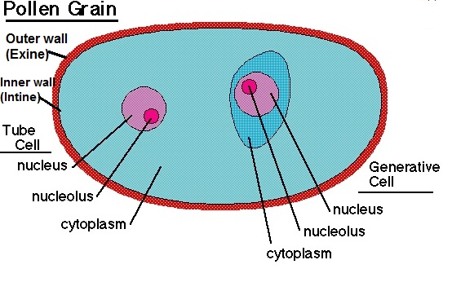
The Mature Pollen Grain
The mature pollen grain consists of two layered cell wall, an inner intine layer and outer exine layer.
The inner wall encloses a large vegetative cell (tube cell) and a smaller generative cell.

Slide 4
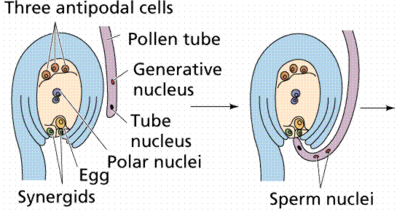
Event after pollination consists of the following steps:
pollen tube growth - when the mature pollen grain lands on the stigma of a flower, the pollen germinate and forms a pollen tube. The inner intine layer of the pollen elongates breaking the outer exine layer to form the pollen tube.
migration of tube cell (vegetative cell) to the tip of the pollen tube
division of the generative cell- as the pollen tube grows, the generative cell divides into two sperm cells.
the pollen tube further extends down the style towards the embryo sac
entry of the pollen tube into the embryo sac through the micropyle

Slide 5
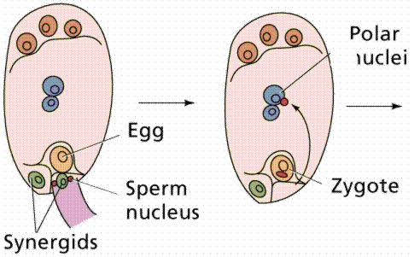
at the same time, the pollen tube tip bursts open releasing the two sperm cells. One sperm cell fuses with the egg cell in the embryo sac resulting in the formation of a zygote
the second sperm cell migrates to the central part of the embryo sac and fuses with the polar nuclei. This makes a fusion of three separate nuclei to form one nucleus- a process known as triple fusion. The result of this process is the formation of the cell that forms the endosperm.
the zygote and endosperm formation are both fertilization processes, hence referred to as double fertilization.

Slide 6
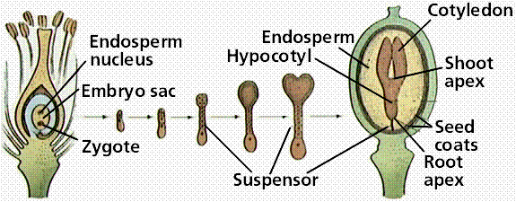
Embryogenesis
The zygote formed after fertilization undergoes a series of mitotic cell divisions. Subsequently, there is differentiation of cells into tissues and organs forming a mature embryo. This process is referred to as embryogenesis.

Slide 7
Stages of embryogenesis:
The zygote initially divides transversely into two cells- axial and basal cells.
The cell towards the micropylar end is the basal cell. This cell divides further anticlinally to form a ‘ladder’ of cells called the suspensor. The suspensor functions as an anchor and also draws nutrients from the parent plant (ovary) to the developing embryo.
The cell away from the micropyle end, known as axial cell divides in different planes – anticlinally and periclinally, to form a pro-embryo.
The pro-embryo continues dividing in different planes that assumes a nearly spherical shape – the globular embryo.
Initially the cells of the globular embryo are undifferentiated. Up to this stage the development of the embryo is similar in both dicots and monocots.
Shortly afterwards, the various tissue systems of the embryo differentiates to form the primary meristem.

Slide 8
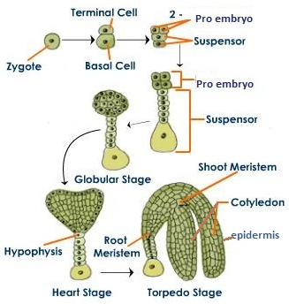

Slide 9
The primary meristem is made up of the Protoderm, Ground meristem and Procambium
Protoderm -
The cells in the outermost layer of the embryo divide periclinally i.e. parallel to the surface of the embryo and the outermost layer then becomes the protoderm. This is the tissue that eventually becomes the epidermis.
Ground meristem and Procambium –
The remaining cells below the protoderm then undergo changes in size, number of vacuoles and the density of cytoplasm. The cells with a less dense cytoplasm and relatively more vacuoles become the ground meristem which eventually forms the cortex. This tissue (ground meristem) is located just beneath the protoderm. The remaining cells with dense cytoplasm and relatively fewer vacuoles form the procambium. These are relatively smaller than and surrounded by the ground meristem cells. These cells give rise to the vascular tissue.

Slide 10
The cotyledons of the embryo begin to form either during or after the formation of primary meristems. The development of the cotyledons differ for dicots and monocots.
In dicots the pattern of cell divisions results in globular embryo becoming a heart shaped embryo. This is because the cell division is more rapid at the sides of the dome of the globular embryo which results in the formation of two cotyledons, hence the name dicotyledon or simply dicot
In monocots the globular embryo assumes a cylindrical form as only one cotyledon develops. This is because cell division rates are even all over the entire dome of the globular embryo which elongates forming a single cylindrical cotyledon, hence the name monocotyledon or simply monocot
The rate of cell division at the protrusions of the heart shaped embryo continues to be higher than the rest of the embryo cells. This result in the elongation of the protrusions and the heart shaped embryo then assumes the shape similar to the torpedo bomb-torpedo shaped embryo.
In both the heart shape and torpedo shape embryos, you will be able to observe the well developed three primary meristem tissues.

Slide 11
Simultaneously along with these stages of embryo development, the endosperm cell (which resulted from the triple fusion of two polar nuclei and a sperm cell) divides several times in different planes filling up most of the embryo sac space. These cells store nutrients from the parent plant.
As development of the embryo progresses the ability of cells to divide gets restricted to certain areas of the embryonic structure.
In dicots cell division becomes restricted to two positions, an area between the cotyledons which becomes the shoot apical meristem and at the base of the torpedo shaped embryo which also becomes the root apical meristem. The positions of these two meristems are linear forming an embryonic axis.
The cotyledons and the rest of the embryonic axis consist of the three primary meristematic tissues.

Slide 12
b. In monocots the restricted area of the cell division occurs on only one side beneath the cotyledon forming the shoot apical meristem. A protective sheath like structure from the base of the cotyledon called the coleoptile encloses the newly developed shoot apical meristem. Below this apical meristem, in a linear arrangement, the root apical meristem also develops covered by the coleorhiza.
The cells of the shoot and root apical meristems are the sources of all the new cells required for the development of the seedling and adult plant body.
The process of embryo growth requires energy which is provided by nutrients that continuously flow from the parent plant to the ovule tissues. Initially the suspensor transports the nutrients from the ovule tissues to the developing embryo.
As the embryo expands the suspensor is crushed. In both dicots and monocots, the endosperm then provides the source of nutrients for the growing embryo. In some dicots as the embryo matures, the unutilized nutrients from the endosperm become reserved in the cotyledon which makes them fleshy. For example in cowpea seeds.

Slide 13
In monocots however, the cotyledons provide the nutrients for the growing embryonic axis. This subsequently shrinks the cotyledon that ends up lying to one side between the embryonic axis and the endosperm. In monocots, the main storage tissue is the endosperm found within the seed. For example, as in the maize seed.
Finally the connection between the ovule and the parent plant is severed. Thus there is no more nutrient flow to the embryo from the parent plant. The embryo therefore becomes nutritionally independent and is enclosed by ovule tissues called integuments. This is the matured SEED.
Before the seed is shed from the parent plant, the non embryonic tissues inside the seed get desiccated.

Slide 14
Description of the Mature Dicot and Monocot seed
A seed is a miniature embryonic plant enclosed by a covering, the seed coat and with some reserved nutrients. Seeds consist of the following parts, an outer covering called the seed coat, an embryonic axis and storage tissue.

Slide 15
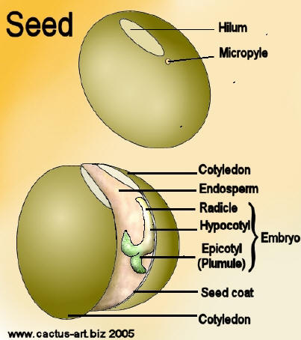
Structure of the Dicot seed (bean seed)
The shape of dicot seeds varies among dicot plants. They can be rounded (bambara bean), cylindrical (groundnut) or kidney shaped (cowpea and canavalia) etc.
The bean seed is flat, kidney-shaped and has a notch on one side. There is a long white scar along the notch. This scar is known as the hilum.
A small pore called micropyle is located at one end of the hilum.

Slide 16
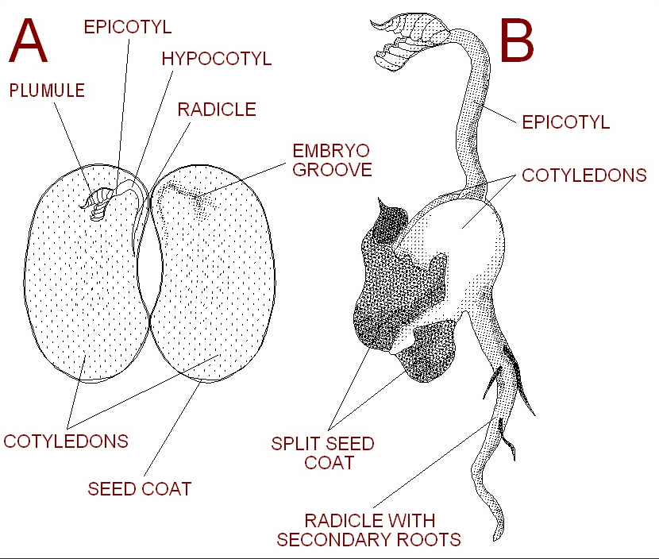

Slide 17
1. Seed coats:
Is having 2 layers: Outer seed coat TESTA, inner coat TEGMEN.
Within the surface of testa there is a tiny opening- MICROPYLE through which water enters and germination begins.
2. Cotyledons
There are two fleshy cotyledons in bean seed – due to stored food in the form of protein and starch grains.
They are connected with each other along the longitudinal embryo-axis.
Since the cotyledons completely enclose the nutritive endosperm during the embryonic development and become fleshy, there is no separate existence of the endosperm. Hence, such a seed is known a exalbuminous or nonendospermic seed.
In the middle of the two cotyledons is the tiny embryo, waiting to grow.

Slide 18
Embryo
The embryo is the infant plant made up of two parts: the radicle, or the first root, and the plumule, or the first leaves. When water enters the micropyle, the radicle starts growing and moves down and out through the micropyle into the soil below. Then the plumule swells and grows, pushing its way through the testa and up through the soil until it reaches the light.
Radicle:
There is a small, rod-shaped part of the embryo-axis that lies near the micropyle. During seed germination the radicle is the first to emerge through the micropyle. The radicle develops into primary root of the normal tap root system.
Plumule:
It is the first embryonic apical bud having a growing point covered by delicate undeveloped leaves. Plumule is connected with the radicle by means of hypocotyl. During seed germination they give rise to shoot system.

Slide 19
Hilum
The hilum, or scar, on a bean is the site where the bean originally attached to the fruit of the plant. It is the 'navel' of the bean and can be found on the indent of the bean on the surface of the testa.
Hypocotyl
The hypocotyl is the area between the root and the cotyledons. It will grow and become part of the stem where it connects to the root.
Epicotyl
The epicotyl is the area above the cotyledons and below the plumule. It will grow and become the stem of the plant.

Slide 20
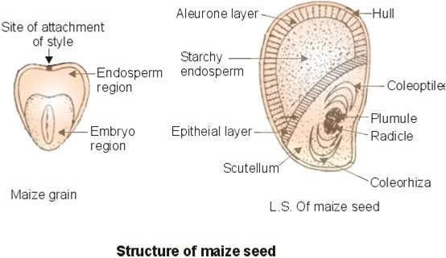
Structure of monocot (maize seed)

Slide 21
Endosperm:
The Endosperm occupies about 2/3 of the total seed and is located in the broader part of the maize grain. There is a continuous layer of the large cubical cells immediately beneath the hull and is called aleurone layer. This aleurone layer contains protein granules. The rest of the endosperm consists of starch-laden cells, which also contain some lipid

Slide 22
Embryo:
The embryo of the maize grain is located beneath the endosperm.
It is demarcated from the latter by a single layer of epithelial cells.
The embryo consists of a radicle and a plumule.
The radicle is partially covered and protected by colerorhiza.
The plumule is partially covered and protected by coleoptile.
All these parts are enclosed completely in shield-shaped scutellum. The cotyledon is called scutellum.
The epithelial layer mentioned above is the part of scutellum. The cells of the epithelial layer secrete digestive enzymes during seed germination which digest the nutrients in the endosperm and absorb them. These nutrients help in the development and growth of the seedling.

Slide 23
SEED GERMINATION
Under normal conditions the mature embryo does not continue to grow while the seed is still attached to the parent plant. After dispersal of the seed, if environmental conditions are favorable there is resumption of the growth of embryo inside a viable non-dormant seed. This is the process known as germination.

Slide 24
A MATURE SEED
Viable (living embryo)
Non viable (dead embryo)
Dormant
Non-dormant
The mature embryo before the seed is shed from the parent plant enters a resting stage during which its metabolic rate is very low.

Slide 25
The Process of seed germination
Seed absorbs water by imbibition (a physical process in which living or dead plant materials takes up water or liquid mainly by adsorption) and seed coat softens and burst. It is the first sign of germination.
The imbibed water hydrates the cytoplasm which leads to activation of enzymes in the embryonic axis that mobilize the reserve food material for growth.
Chemical energy stored in the form of starch is converted to sugar, which is used during germination.
There is an increase in the respiration rate that generates energy (ATP) for cell enlargement and cell division. This results in increase in size of the embryo which pushes against the seed coat and it bursts open.
The growing radicle is the first to emerge out of the seed and helps to anchor the seed in the soil. It also allows the embryo to absorb minerals and water from soil.
The germination process ends as soon as the radicle emerges from the seed coat.

Slide 26
Mobilization of reserve food material for development of seedling in monocot
On hydration of the seed, the cells of the embryonic axis produce gibberellic acid
After 24 hours the scutellum also produces gibberellic acid.
The gibberellic acid is transported to the aleurone layer where it induces the synthesis of an enzyme, α-amylase. The enzymes namely protease, ribonuclease, β-1,3-glucanase and lipases are already present in the aleurone layer. These enzymes are hydrated and activated. After hydration all 5 enzymes (α-amylase, protease, ribonuclease, β-1,3-glucanase and lipase) in the aleurone layer are released into the endosperm.
These enzymes break down the stored food material in the endosperm cells –
α-amylase breaks down starch to sugar
proteases break down proteins to amino acids
ribonuclease breaks down RNA to nucleic acid
β-1,3-glucanase breaks down hemicelluloses (a component of the cell wall of endosperm cells) to sugars
lipases breaks down oils into glycerol and fatty acids

Slide 27
The broken down food material are transported from the endosperm through the scutellum into the growing regions (root and shoot apices) of the embryonic axis.
Prior to the transport of nutrients from the endosperm, the embryo produces IAA (Indole Acetic Acid) that is transported to the scutellum for the development of vascular tissue in the scutellum.
The developed vascular tissue are the conduit/channel for the nutrient (sugars, amino acids, nucleic acids)flow to the embryonic axis.
The growing regions of the embryonic axis use the nutrients for the cell division and expansion of the divided cells which will result in increase in size of the embryonic axis – seedling growth.

Slide 28
Mobilization of reserve food material for development of seedling in dicots
Enzymes namely proteases, ribonuclease, β-1,3-glucanase and lipases are already present in the cotyledons.
α-amylase is freshly synthesised prior to mobilization of food reserve in the cotyledon.
These enzymes break down the stored food material in the cotyledon or endosperm cells
α-amylase breaks down starch to sugar
proteases break down proteins to amino acids
ribonuclease breaks down RNA to nucleic acid
β-1,3-glucanase breaks down hemicelluloses (a component of the cell wall of endosperm cells) to sugars
lipases breaks down oils into glycerol and fatty acids
In addition, cytokinins (another group of plant hormones) are also thought to be involved in controlling breakdown of reserves in the seeds.
The breakdown reserves are transported to the embryonic axis for cell division and enlargement of the divided cells leading to increase in size of the embryonic axis – seedling growth.

Slide 29
Modes of Germination or Seedling Emergence
The way in which the shoot emerges from the seed during germination varies from species to species.
The shoot can either be accompanied by the cotyledons or endosperm or it can emerge alone leaving the cotyledon or endosperm underground.
Thus there are 2 modes of germinations: Epigeal and Hypogeal

Slide 30
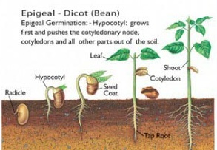
Epigeal germination
In epigeal germination, both the plumule and cotyledons are thrust out of the ground by the elongation of the hypocotyl.
In this type of germination the cotyledon assume additional functions.
They protect the plumule as it is pushed through the soil.
They may also become chlorophyllous and photosynthesize. Eg. Cowpea, Mango, Castor, etc.

Slide 31
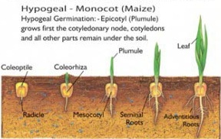
Hypogeal germination
In hypogeal germination, the epicotyls elongate thrusting the plumule upwards out of the ground leaving the cotyledons below the ground. Eg. Maize, Rice, Millet, Garden pea, etc.

Slide 32
MITOSIS
Cell are the building block of life
Cell division cycle is basically a series of events which occurs during cell division and replication
In prokaryotic cells, i.e. cells without nucleus, the cell cycle occurs through a process called binary fission
In eukaryotic cells, i.e. cells with nucleus, the cell cycle can be divided into four distinct phases: G1 phase (cell growth period), S phase (DNA synthesis or replication occurs), G2 phase (cell undergoes a period of rapid growth to prepare for mitosis) and M phase (mitosis).

Slide 33
G1 phase, S phase and G2 phase are collectively known as interphase, wherein the cell grows, collects nutrients for mitosis and duplicates its DNA
M phase (mitosis and cytokinesis), is the process in which the cell divides itself into two distinct cells, termed as daughter cells

Slide 34
Before cell division occurs, the cell first has to replicate the chromosomes so each daughter cell can have a set. When the chromosomes are replicated and getting ready to divide, they consist of two, identical halves called sister chromatids which are joined by a central region, the centromere. Each chromosome is one long molecule of DNA and special proteins. DNA makes up the genes, and we say that genes are “on” chromosomes, or chromosomes “contain” or are made of genes.

Slide 35
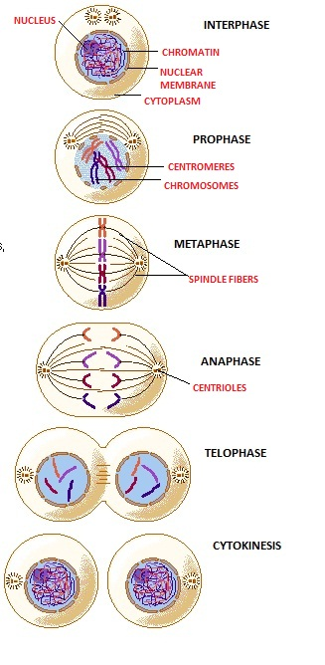

Slide 36
Conditions required for seed germination
Availability of water
Availability of oxygen
Suitable temperature
Sometimes light

Slide 37
Water –
A seed contains 10-15% of water and is generally dehydrated. So the viable dormant seed has to absorb water through micropyle or through permeable seed coat to become active and exhibit germination.
Water hydrates the seed making the seed coat to soften, swell and weaken and also hydrates the embryo.
Enzymes that are present in the seeds are activated because of the hydration.
It is also used for the cell enlargement and cell division which results in the elongation of the radicle.
As the radicle elongates it pushes its way through the testa which has been soften and weakened and emerges out of the seed.
When the radicle emerges out the germination is completed.

Slide 38
Oxygen –
In the dormant condition the seeds respiratory rate is very low due to low metabolic rate and so oxygen is required in very small quantities.
For germination, oxygen is needed in large quantities. The seeds obtain this oxygen from the air contained in the soil.
Oxygen is required for the aerobic respiration which provides the growing embryo with maximum energy for cell division and cell enlargement.
In the absence of oxygen, the embryo undergoes anaerobic respiration that results in the formation of ethanol or acetic acid which are poisonous to the embryo and hinders its further growth.

Slide 39
Temperature –
a suitable temperature is required for germination because of enzymes that catalyze the metabolic activities. Enzymes haves minimum, optimum and maximum temperature requirements.
The range of temperature requirement is higher for tropical plants then for temperate. This is reflected in the temperature requirement of seeds and the best germination occurs at the optimum temperature range.
Enzymes are sensitive to heat and are denatured (completely destroyed) at higher temperature above 60⁰C. Below 0⁰C enzymes are normally inactivated but not destroyed.
Examples of cardinal temperatures (⁰C) for germination of Grains/seeds
Grain/Seed | Minimum | Optimum | Maximum
Zea mays (Maize) | 8-10 | 32-35 | 40-44
Cucumis melo (Melon) | 16-19 | 30-34 | 45-50
Oryza sativa(Rice) | 10-12 | 30-37 | 40-42

Slide 40
Light –
Not all the seeds are affected by light. However, the seeds of certain grasses and some varieties of lettuce require light for germination.
These seeds will not germinate in absence of light because of an inhibitor which is only broken down by in presence of light.
Most of the small sized seeds require light for germination and their germination is inhibited when buried deep in the soil.
In contrast, the seeds of other plants such as onion, geraniums and poppies will germinate only in the dark. In these light stimulates the synthesis of compounds that inhibit seed germination.

